Slide 1

Saciva: University Clustering 1B
AI Studio Final Presentation
Break Through Tech Los Angeles @UCLA
December 6th, 2024
Notes:
Nam

Slide 2


SACIVA: Empowering International Students
Name Meaning | Close friends or minister in Sanskrit
Logo Symbolism | Abstract representation of embracing hands
Mission | Guide international students, foster inclusion
A secure platform addressing networking, housing, and roommate challenges for over 1 million international students in the USA.
Notes:
Nam
Let’s get to know a little bit about Saciva
SACIVA is a platform designed to empower international students by addressing challenges related to networking, housing, and finding roommates. Inspired by the Sanskrit word for "close friends" or "minister," SACIVA fosters inclusion and support for over one million international students in the USA. The logo symbolizes embracing hands, reflecting the mission to guide students and create a welcoming community.

Slide 3






Meet Our Team!
<insert jpg>
<insert jpg>
Nam Vien Statistics & Data Science @ UCLA
Parini Gandhi Computer Science @ USC
Joann Sun Computer Science @ CSUF
Jiarui Song Statistics & MathEcon @ UCLA
Anita Demirci
Computer Science @CSULB
Notes:
Everyone

Slide 4



AI Studio Teaching Assistant & Challenge Advisor
<insert jpg>
<insert jpg>
Dominic Diaz Fall Studio TA
Applied Mathematics PhD Candidate @ Cornell University
Abhi Medikonduri Challenge Advisor
CEO of Saciva
DePaul University Alum
in Business Analytics
Notes:
Nam
We are honored to welcome our TA, Dominic, our Challenge Advisor, Abhi, and the program representative to our final presentation today.

Slide 5
Presentation Agenda
AI Project Overview
Data Understanding & Data Preparation
Weather
Cost of Living & Personal income
U.S. Universities
Campus Safety
Modeling & Evaluation
Clustering
Profiling
Key Findings
Conclusion and Q&A
Notes:
Nam
Here’s the agenda for our presentation:
We’ll start with an overview of our AI project, providing context and goals.
Next, we’ll dive into data understanding and preparation, covering key datasets such as weather, cost of living, personal income, U.S. universities, and campus safety.
Then, we’ll discuss modeling and evaluation, focusing on clustering, profiling, and key findings.
Finally, we’ll conclude with a summary of our insights and open the floor for questions.

Slide 6





AI Studio Project Overview
Ever spent hours toggling filters, struggling to find what you need?
Traditional filters require users to specify preferences or navigate irrelevant options, causing frustration. For international students, this is worsened by unfamiliarity with their environment, making it harder to find trustworthy resources, compatible roommates, and local networks.
Our solution: Saciva combines machine learning with user-centric design to streamline the process:
Security: Student email verification ensures authenticity, eliminating fake profiles.
Privacy: In-platform messaging safeguards personal information.
Wide Network: Expands connections beyond single universities, fostering city-wide networks.
Smart matching: Uses clustering to group students based on geographic proximity and preferences, reducing the reliance on manual filtering.

Slide 7
AI Studio Project Overview
Ever spent hours toggling filters, struggling to find what you need?
Imagine being an international student…
Notes:
Joann Imagine being an international student, staring at your screen in frustration as you toggle through endless filter combinations. You try filtering by university - but you don't know all the schools in the area. Switch to filtering by city, and you miss great options just outside city limits. Every choice hides connections rather than helps you find them.
Traditional filters are broken. When you're new to a country, trying to find roommates, build a network, and connect with fellow students, the last thing you need is technology standing in your way.
But what if there was a better way?

Slide 8
Our Solution: SACIVA
Saciva combines machine learning with user-centric design to streamline the finding community, network, and more for international students:
Security: Student email verification ensures authenticity, eliminating fake profiles.
Privacy: In-platform messaging safeguards personal information.
Wide Network: Expands connections beyond single universities, fostering city-wide networks.
Smart matching: Uses clustering to group students based on geographic proximity and preferences, reducing the reliance on manual filtering.
Notes:
Joann
Meet Saciva. After seeing how broken traditional filters are, we created something better. A platform that actually understands how international students connect and network in the real world.
Think about it - when you're looking for roommates or trying to build your network, you don't care about city boundaries or university names. You care about finding students in your area who share your interests. That's exactly what Saciva delivers.
We use machine learning to create natural clusters of universities based on location and commute patterns. No more manual filtering through endless lists of schools.

Slide 9
“
Why Clustering Over Filters?
Filters are inherently limited by their reliance on predefined categories and user input.
Fragment Results: Users may miss connections or opportunities outside their specific filter criteria.
Require Prior Knowledge: International students may not know the best neighborhoods or universities to connect with.
Time-Consuming: Manually adjusting and toggling through filters is tedious and inefficient.
By clustering universities geographically:
Broader Connections: Students are grouped with others within a practical commuting radius (e.g., 1 to 1.5 hours), promoting regional collaboration and resource sharing.
Inclusive Matching: Groups are formed organically, ensuring no one is excluded due to rigid filter parameters.
Simplified Navigation: Students can easily explore options within their cluster, reducing decision fatigue.
Saciva leverages clustering to create intuitive, location-based networks that make finding housing, roommates, and local connections seamless and stress-free.

Slide 10
“
The goal of our project is to build a clustering model to help international students in the U.S. network, find housing, and connect with roommates, without having to use filters.
Notes:
Joann

Slide 11
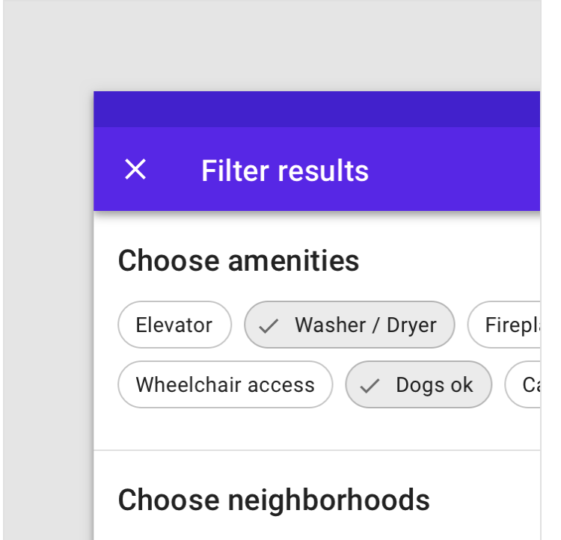
Business Impact
Why Clustering Over Filters?
Filters are limited by reliance on predefined categories and user input
Users may miss connections or opportunities outside their specific filter criteria
Requires prior knowledge
Time-consuming
Creates natural regional connections within commute radius
Helps users discover relevant nearby opportunities
Especially benefits international students with limited local knowledge
Accounts for complex commuting patterns between cities and suburbs
Notes:
Nam
Clustering offers advantages over filters by overcoming the limitations of predefined categories and user input. While filters require prior knowledge and can miss broader opportunities, clustering creates natural regional connections within commute radii. This approach helps users, especially international students with limited local knowledge, discover relevant nearby opportunities and account for complex commuting patterns between cities and suburbs.
By combining smart geographic clustering with user preferences, we're building a platform that finally reflects how students actually network in the real world.

Slide 12
Our Approach and Timeline
Data Preparation/Data Understanding
Gathering, cleaning, and exploring the data to make sure it’s ready for analysis and clustering.
Profiling
Analyzing the characteristics and features such as climate, cost of living, and safety scores for each cluster to understand their significances.
Sept 2024
Nov 2024
Aug 2024
Oct 2024
Clustering
Applying clustering algorithms to segment the data into clusters based on geographic location.
Testing
Validating clustering and profiling results through performance metrics to ensure accuracy and robustness.
Notes:
Anita

Slide 13


Resources We Leveraged
Project Management & Shared Resources:
Google Colaboratory
Google Drive
GitHub
Discord/Google Meet/Zoom
Python Libraries:
Scikit-learn
Numpy
Pandas
Matplotlib
Unsupervised learning libraries
Folium
Notes:
Nam

Slide 14
Summary of Insights & Key Findings
Primary Objective:
Clustering U.S. universities based on geographic proximity (latitude and longitude) to assist international students in networking, finding roommates, and accessing resources.
Key Findings:
Clusters based on geography
Additional profile factors:
Cost of Living Analysis
Climate
Safety/Crime rates
Technical Insights:
We practiced clustering with various models and learned how to evaluate their performance.
Notes:
Parini - emphasize that we will talk about profile factors and datasets later
Geographic proximity aligns with shared infrastructure and regional characteristics, making clusters intuitive and practical.

Slide 15
What is Clustering?
Technique to automatically group similar items based on their characteristics.
In Our Case: Grouping universities by geographic location to create natural networking zones
Algorithms We Explored:
DBSCAN (Density-Based Spatial Clustering): Ideal for geographic data, finds natural groupings without predefined cluster count
Mean Shift: Centers clusters around density peaks, adapts to data distribution
Agglomerative: Builds hierarchical clusters from the bottom up
Evaluation Metrics:
Silhouette Score (ranges from -1 to 1): Measures how similar points are to their own cluster vs. other clusters.
Close to 1: The item fits well in its group.
Close to 0: The item could belong to another group.
Negative: The item is in the wrong group.
Notes:
Jiarui

Slide 16
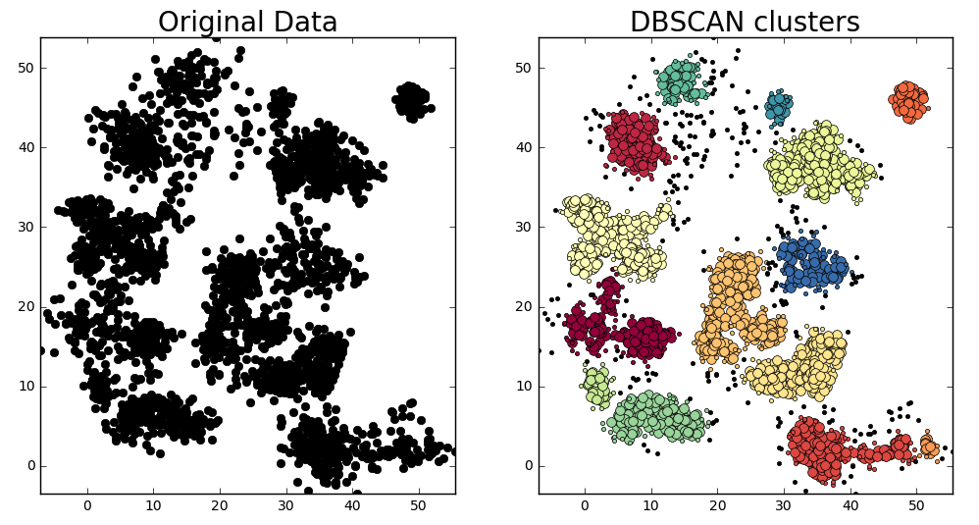
DBSCAN (Density-Based Spatial Clustering of Applications with Noise)
An algorithm that groups points (e.g., universities or people) based on density.
How it works?
It connects points within a certain distance and expands groups by adding nearby points if they are dense enough.
Points too far from any group are marked as noise.
Unlike other methods, it doesn’t require deciding the number of groups in advance.
Source: Image by Preethi Thakur
Notes:
Jiarui

Slide 17
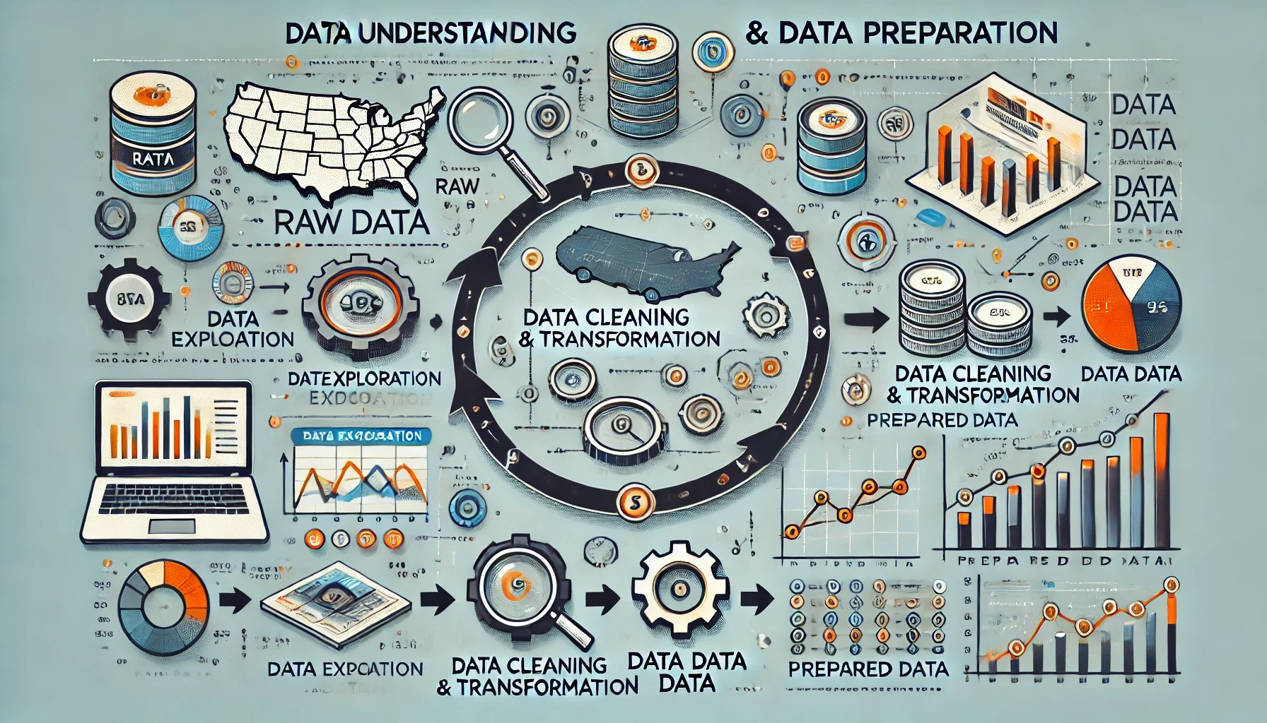
Data Understanding & Data Preparation
Notes:
Parini

Slide 18
Data Understanding & Data Preparation
Data Exploration and Characteristics:
Explored geographic data of U.S. universities (latitude, longitude) and cost of living indicators.
Conducted Exploratory Data Analysis (EDA) to examine distribution and relationships, identifying minimum and maximum values (e.g., cost of living extremes).
Used visualization techniques to map geographic locations alongside cost data for better insights.
Data Preparation Steps:
Handled missing values, specifically for geographic and cost data, and normalized cost of living where needed.
Identified and managed outliers to ensure data quality and consistency.
Merged datasets.
Notes:
Parini

Slide 19
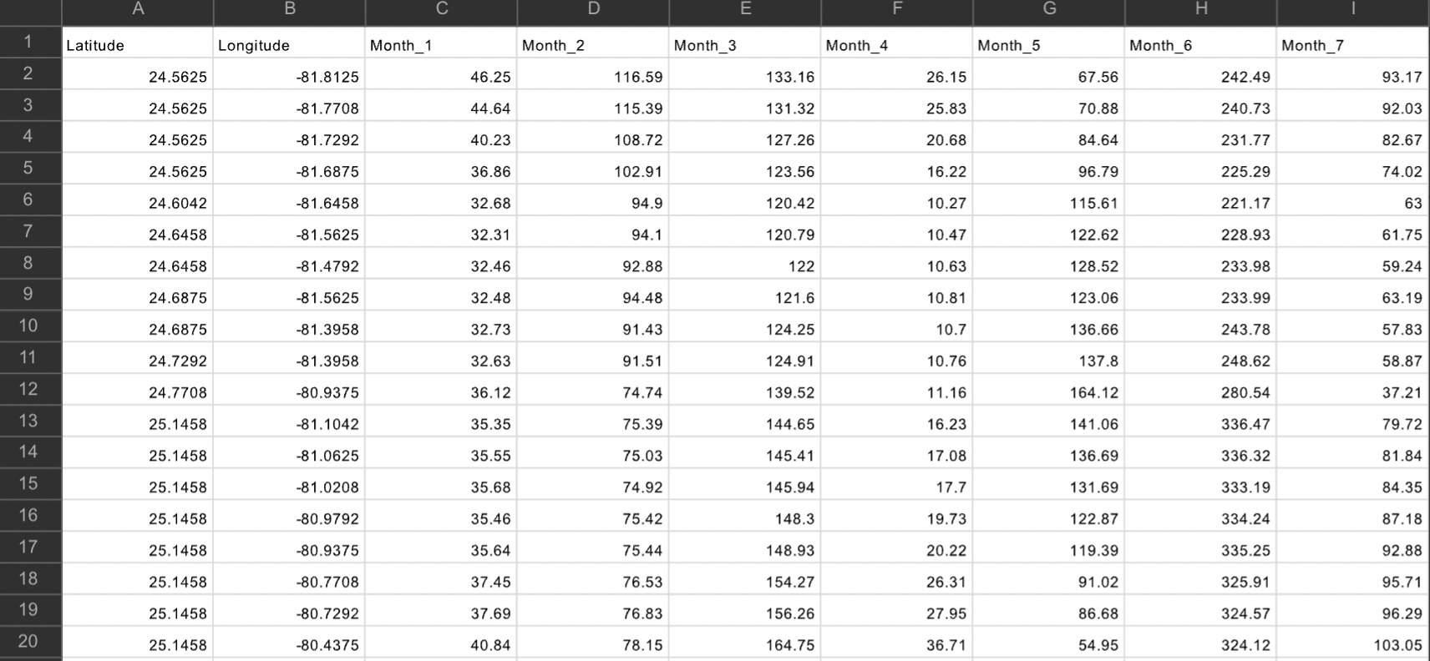
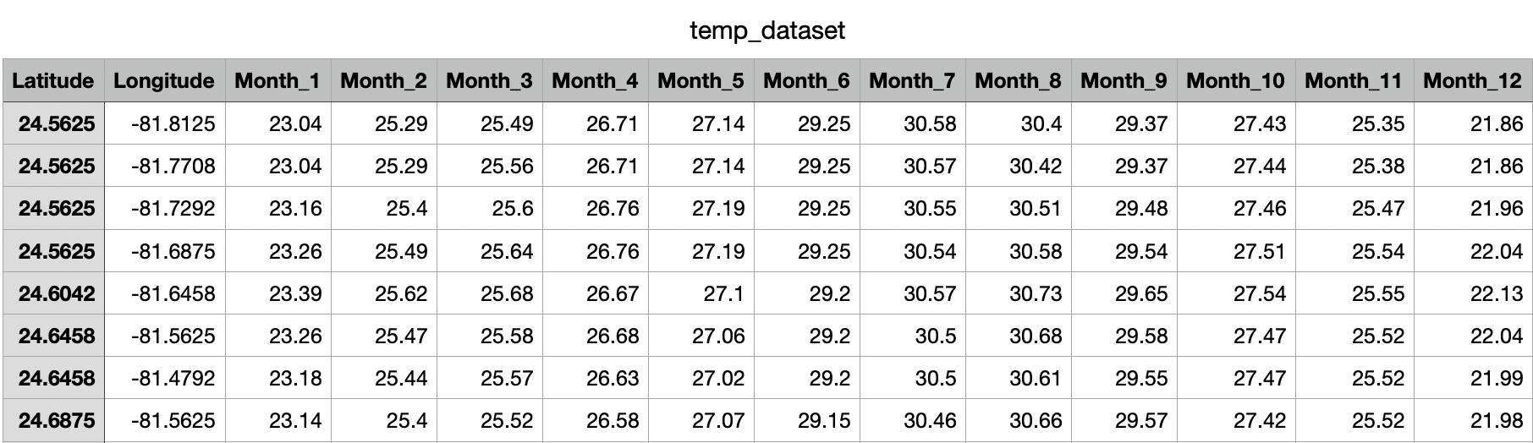
NOAA Weather Datasets
Overview – Precipitation Data:
First two columns indicate the latitude and longitudes of surveyed locations
The following 3-14 columns indicate the total precipitation level in millimeters for that month.
Overview – Temperature Data:
Similar structure where first two columns indicate the latitude and longitudes of surveyed locations
The following 3-14 columns indicate the temperature in Celsius for that month
Notes:
Parini

Slide 20
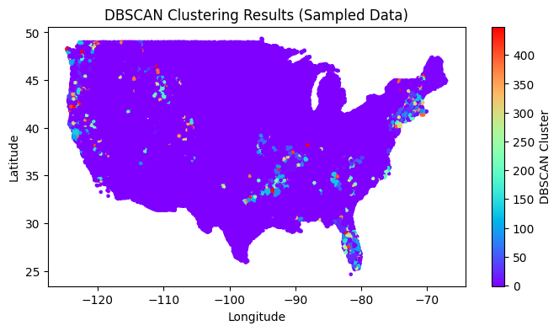
NOAA Weather Datasets
Data Analysis:
Map – purple clusters indicate the most frequently occurring weather patterns across the U.S., while the red clusters indicate the least frequent.
Distinct areas show high or low annual precipitation, defining climate zones.
Most regions experience moderate rainfall, with few outliers on either end.
The average annual precipitation value is 167 , and the highest precipitation value is 504, which occurs during the 1st month, and the lowest precipitation value is 0 during Month 7.
Notes:
Anita

Slide 21
Cost of Living & Personal Income Dataset
Cost of Living Dataset Overview:
510 cities total
Cost of Living Index (CLI) is based on six major expense categories:
Food: 16.1%
Housing: 23.2%
Utilities: 10.1%
Transportation: 18.6%
Healthcare: 9.6%
Consumer Discretionary Spending: 22.3%
CLI of 100 = average cost of living in the United States
Personal Income Dataset Overview:
Groups counties by state
Provides average state income and average income in each of its counties from 2021-2023
Provides percent change from previous years
Notes:
Jiarui
Cities with index values above 100 have a higher CLI than the national average, while values below 100 indicate a lower CLI

Slide 22
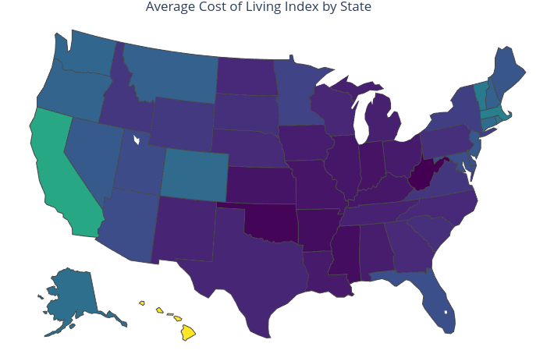
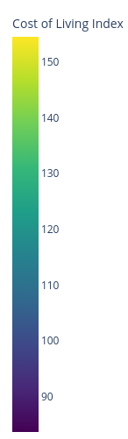
Cost of Living & Personal Income Dataset
Data Analysis:
West Coast (particularly California) and Hawaii dominate the high-cost areas
Most cities in 80-100 range CLI
Most outliers are concentrated in:
California (11 cities)
Hawaii (4 cities)
Massachusetts (2 cities)
Cities are the centroid when clustering
For Personal Income, we focus on Average Income from 2023 (latest in the dataset)
Notes:
Joann
West Coast (particularly California) and Hawaii dominate the high-cost areas
Most cities in 80-100 range CLI
Most outliers are concentrated in:
California (11 cities)
Hawaii (4 cities)
Massachusetts (2 cities)
Consider creating sub-clusters within high-cost regions
Different cities may have very different CLI
Cities are the centroid when clustering
We wanted to know how personal income compares to cost of living in each region
For Personal Income Dataset, we focus on Average Income from 2023 (latest in the dataset)

Slide 23
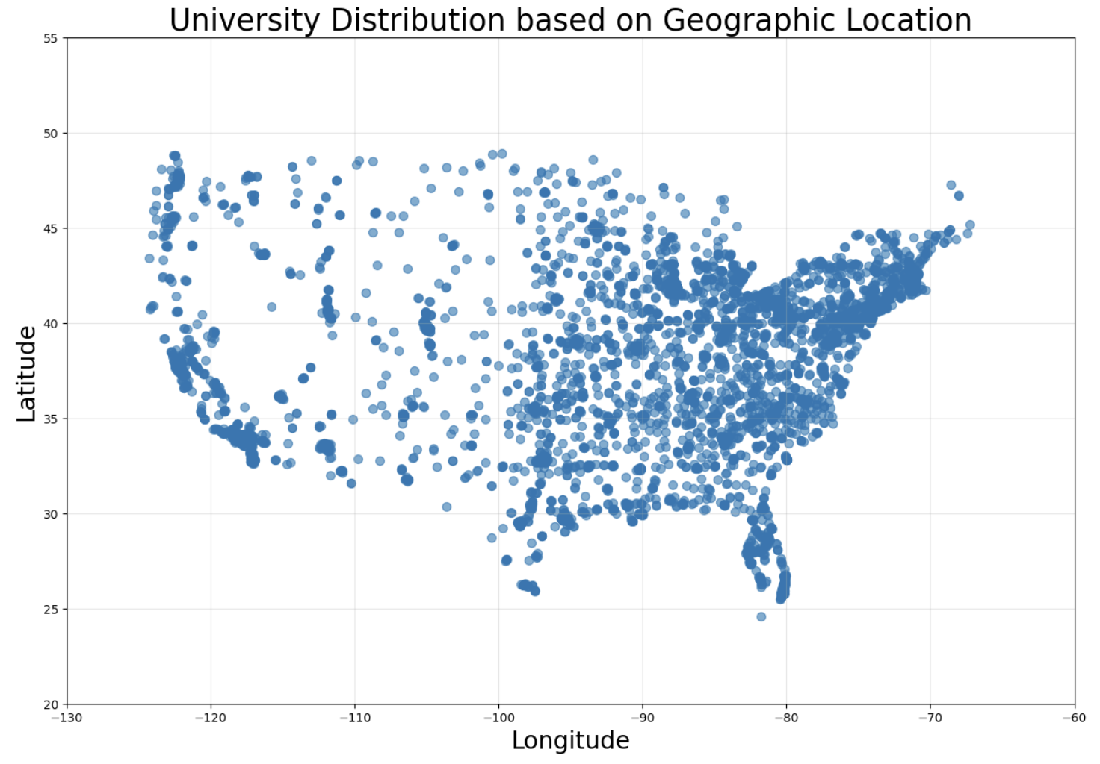
U.S. Universities Dataset
Overview:
6,559 universities and 22 features per university, including:
location, enrollment housing, and employment data
Provide university names and location indicators (latitude and longitude).
Data Analysis:
High-cost cities have dense clusters of institutions.
California, New York, and Texas host the largest student clusters.
Public institutions dominate, followed by private non-profits, highlighting accessibility.
Higher enrollment correlates with larger staff sizes.
California and Texas excel in total enrollment and dorm capacity, showcasing robust on-campus resources.
Notes:
Nam
Our dataset includes 6,500 universities, each with 22 features like location, enrollment, housing, and employment data, with a focus on latitude and longitude. Notable trends reveal high institution density in high-cost cities, with California, New York, and Texas hosting the largest clusters. Public institutions dominate, reflecting accessibility, while private non-profits follow. Analysis shows a strong correlation between enrollment size and staffing, highlighting resource allocation. States like California and Texas lead in total enrollment and dorm capacity, showcasing robust on-campus infrastructure and resources.

Slide 24

Campus Safety Dataset
Overview:
10,499 universities with 49 features for each university documented:
Campus Address & ID
Type of University (Private/Public)
Student enrollment count
Type of Crime and its count
Data Analysis:
We total the crimes into a single crime counter/safety score for each campus
Most common reported incidents:
Burglary and aggravated assault
Strong correlation between campus size (enrollment) and total incident reports
Public universities typically report more incidents, possibly due to larger average size
Data suggests many smaller institutions report zero incidents across all categories
Data quality considerations:
Reporting standards may vary between institutions
Some campuses show incomplete data across years
Notes:
Joann

Slide 25

Modeling & Evaluation
Notes:
Nam

Slide 26

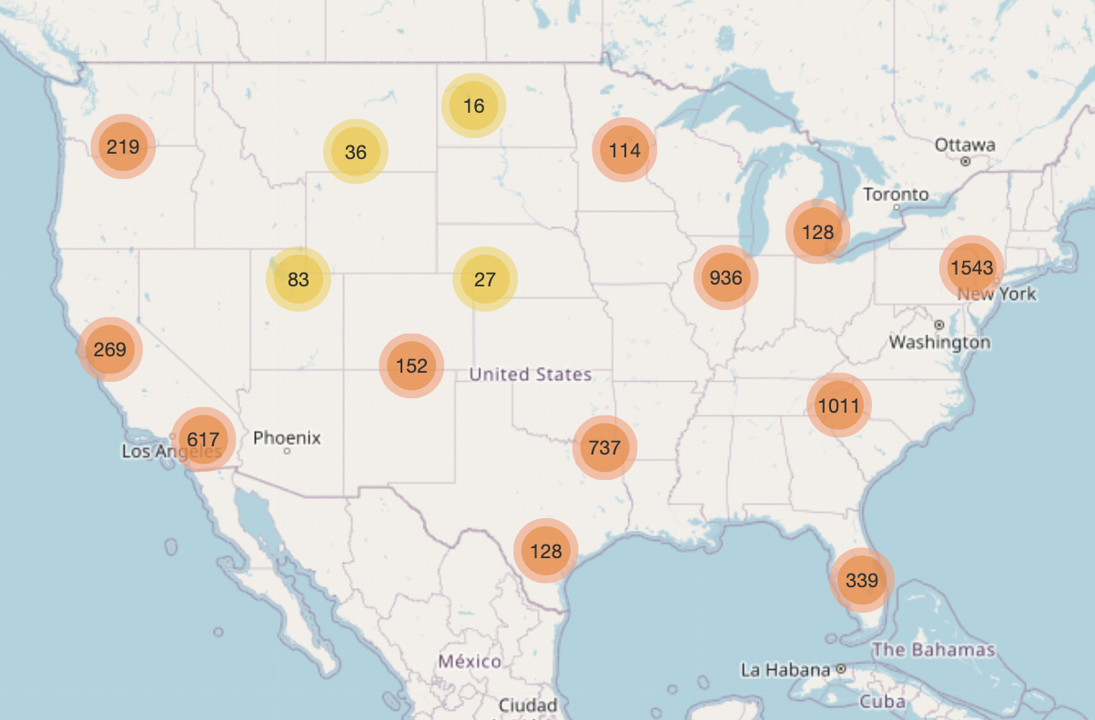
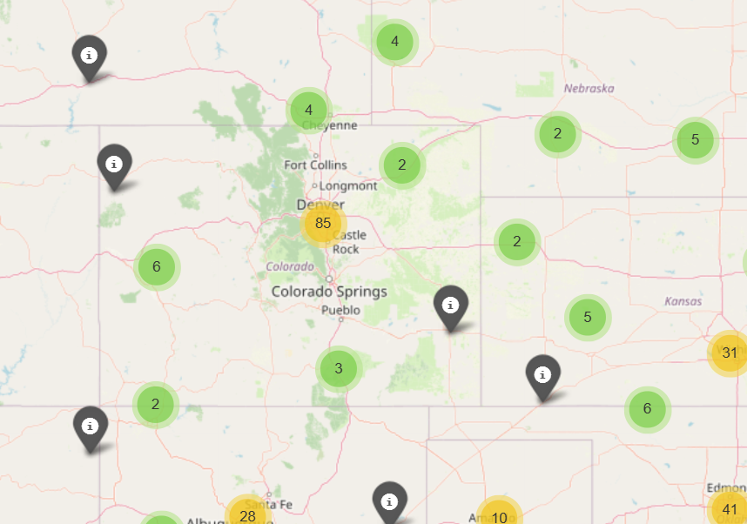
Clustering Map
Notes:
Nam

Slide 27
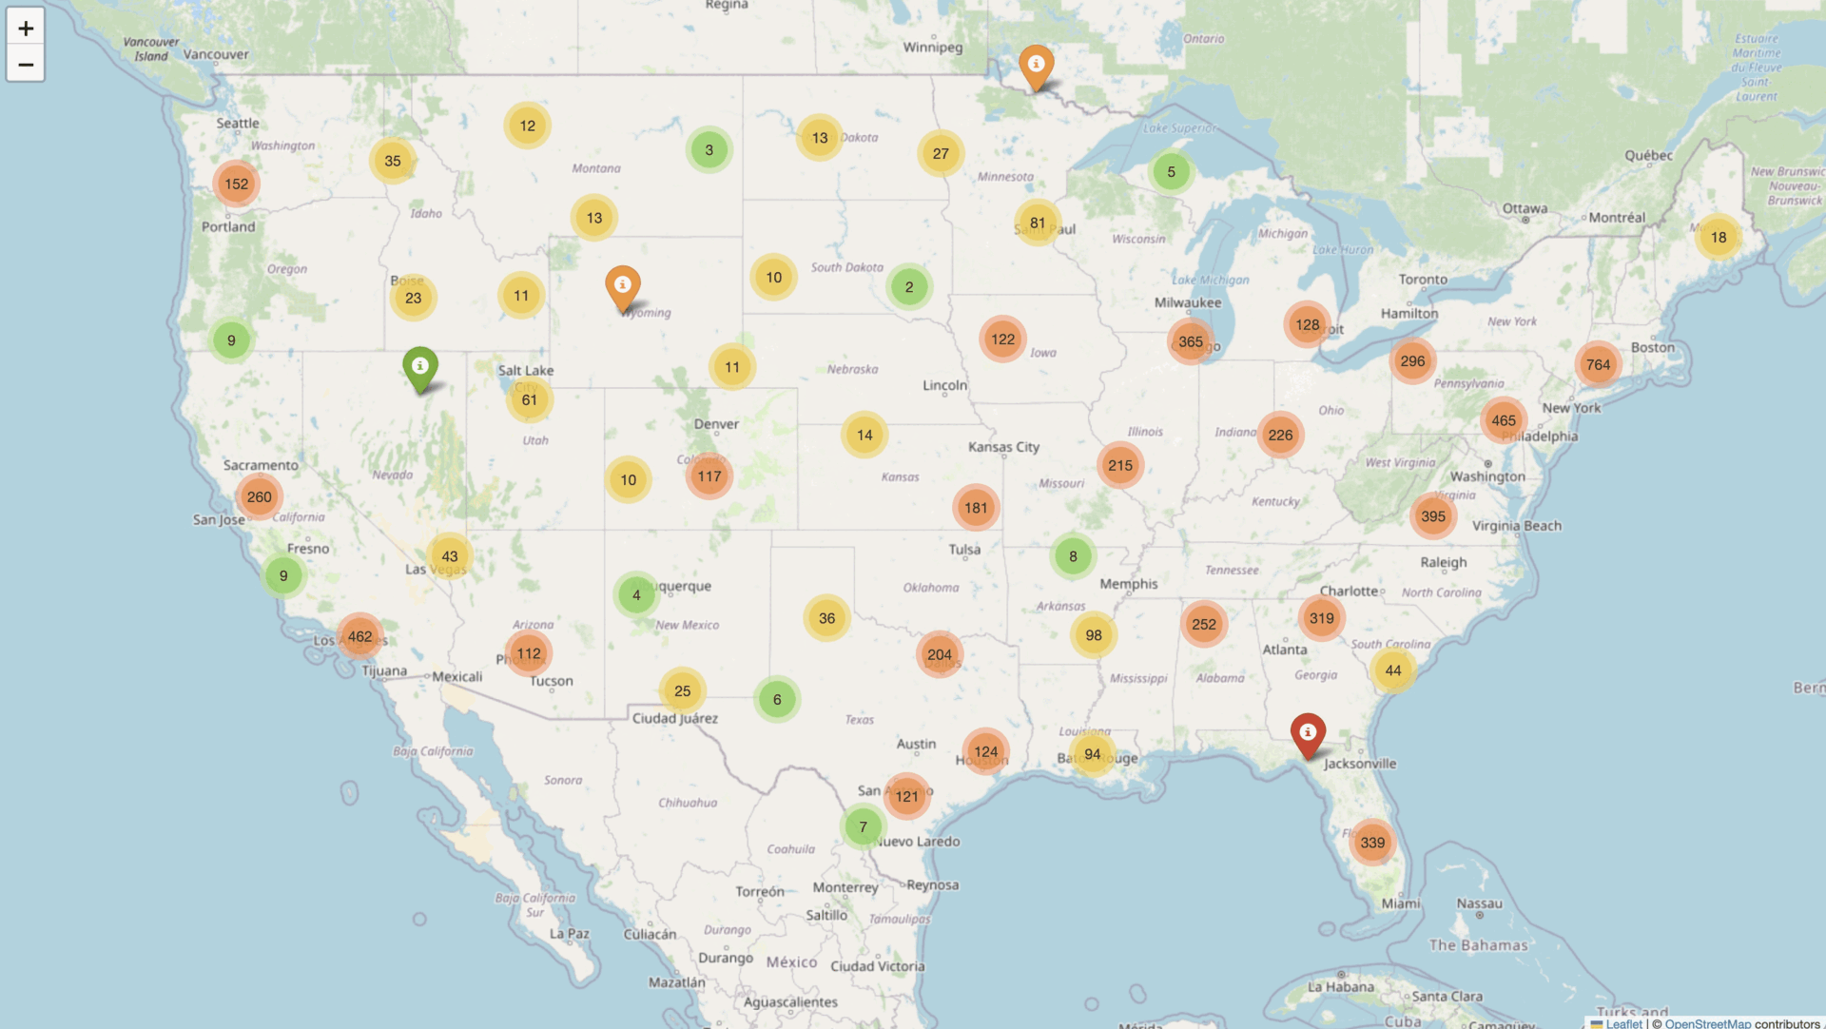
Notes:
Nam
The visualization begins with a broad view of university clusters across the United States, dynamically zooming in to highlight the West Coast. It further narrows the focus to Southern California, emphasizing the region's dense concentration of institutions. Finally, the map focuses on UCLA, displaying key information relevant to the university and its surrounding area.

Slide 28
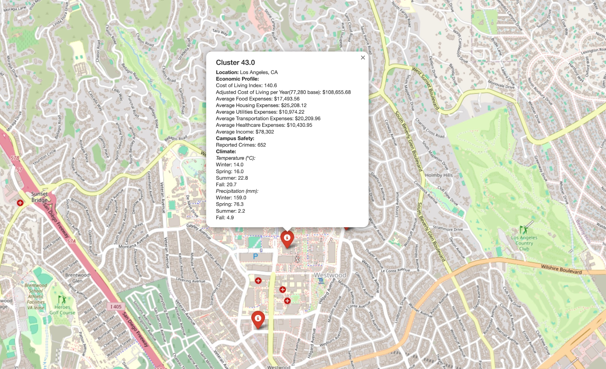
Notes:
Nam
This map highlights Cluster 43.0 at UCLA in Los Angeles, CA, providing an overview of its economic profile, campus safety, and climate data to help understand student living conditions. Key details include cost of living metrics, average expenses, reported crimes, and some climate statistics.

Slide 29
Clustering Model Testing
Finding the best model involved parameter fine tuning
Used Haversine distance to account for Earth's curvature
Set a 20-mile radius for cluster boundaries
Optimized parameters using silhouette scores
Selected appropriate cluster centroids
Epsilon (eps) – using 20 miles (instead of 50) as the max distance for any two universities to be considered clusters
Min_samples: the minimum number of points required within a specified radius/epsilon for a point to be classified as a core point
contribute to forming a cluster in density-based clustering algorithms like DBSCAN
Making a decision about what the cluster centroid would be—geographic mean vs city as centroid
Notes:
Nam
We used Haversine distance to calculate the shortest paths between universities, accounting for Earth's curvature, and set a 20-mile radius as the cluster boundary. Using DBSCAN, we defined a maximum distance (epsilon) of 20 miles and optimized min_samples (the minimum number of points required within a specified radius/epsilon for a point to be classified as a core point) to ensure clusters formed only with sufficient density. Parameters were fine-tuned using silhouette scores, and final centroids were selected to represent cohesive geographic groupings.

Slide 30
Clustering Model Comparison
Model Name | Description | Results | Pros | Cons
DBSCAN | Density-based clustering detects core points and noise | Achieved the highest silhouette score of 0.868 with well-separated and cohesive clusters among the three methods. | Handles noise and detects clusters of various shapes. | Struggles with varying densities, sensitive to parameters.
Mean Shift | Clusters around data density peaks | Also performed well with a silhouette score of 0.831, but slightly less effective than DBSCAN in terms of clustering quality. | No need to specify cluster count; effective with non-linear clusters. | Computationally expensive, sensitive to bandwidth choice.
Agglomerative | Hierarchical merging based on proximity | Resulted in the lowest silhouette score of 0.474, meaning that clusters are not as well defined as DBSCAN and Mean Shift. | Clear hierarchy, flexible linkage methods. | High time complexity, sensitive to noise and outliers.
Notes:
Anita
*define clustering quality

Slide 31
Final Clustering Model Selection: DBSCAN
DBSCAN achieved the highest silhouette score of 0.868
DBSCAN is also robust to noise, which makes it suitable for datasets with varying densities
The number of clusters identified by DBSCAN (excluding noise) is 294, with 695 data points labeled as noise (points that do not meet the density requirements to form a cluster)
* The primary metric used in this analysis is the silhouette score because it effectively measures how similar each point is to other points within the same cluster and how distinct or well-separated a cluster is from other clusters, ensuring cohesive and high-quality clusters.
Notes:
Anita
*define noise and bandwidth

Slide 32
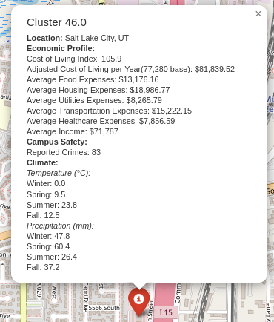
Profiling
Merged datasets using geographic location:
Temperature & Weather
Cost of Living & Personal Income
Campus Crime Reports
Average expenses calculated using Average Consumer Unit Expenditure: $77,280 per year
Libraries/Tools used:
Geopy: Geographic Calculations
Pandas/Numpy: Data Merging & Distance Calculations
Folium: Interactive Map Visualization & Profile→
Notes:
Joann

Slide 33
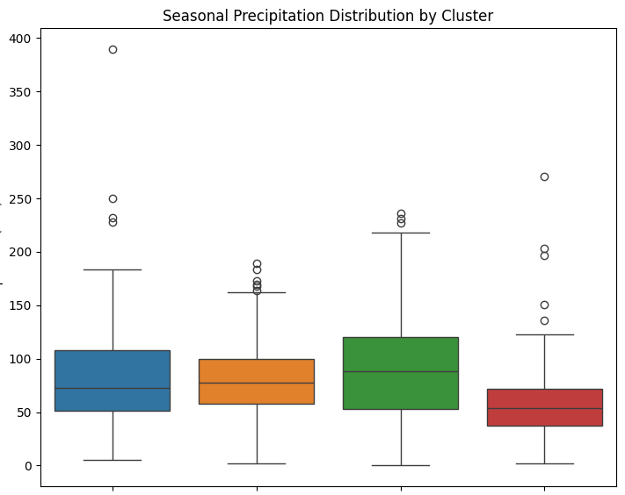
Profiling continued
Why These Profiles?
Seasonal Climate:
Different weather across academic terms
Impacts commute and housing decisions
Economic Factors:
Regional cost of living affects budget planning
Local income levels can indicate job market strength
Safety Analysis:
Campus crime statistics for informed decisions
Helps evaluate surrounding areas
Important for student/parent confidence
Precipitation (mm)
winter spring summer fall
Notes:
Joann
So why these profiles
We focused on three key factors that significantly impact student life and decision-making.
First, seasonal climate. Weather isn't just about comfort - it can really affect the student experience across different academic terms. Think about how weather affects your daily commute, whether you'll need a car, or even which housing options make sense. A beautiful campus tour in summer might give you a very different impression from what you'll experience during winter term.
Then there's the economic factors. Regional cost of living directly impacts how far your budget will stretch - from housing to daily expenses. We also look at local income levels because they can signal the strength of the job market in that area, which is crucial for students planning to work during their studies or stay after graduation.
Finally, safety. We analyze campus crime statistics to help students and parents make informed decisions. These numbers don't just tell us about campus safety - they give us insights into the surrounding areas too. This kind of data can help build confidence in choosing where to spend the next few years of your academic journey.

Slide 34
Insights and Key Findings
Improved user experience by replacing manual filtering with intelligent cluster-based recommendations:
Used DBSCAN (0.868 silhouette score) to achieve 294 clusters reflecting student mobility patterns.
Considered commuter proximity instead of strict city boundaries.
Combined data sources to profile areas by housing affordability, climate, safety, and network access.
Enabled informed decisions for international students.
Established a foundation for automated, preference-based student matching to avoid manual research and navigating complex city boundaries.
Notes:
Parini

Slide 35

Final Thoughts
Notes:
Parini

Slide 36
What We Learned
Technical Skills & Takeaways:
Real data needs heavy cleaning unlike neat academic datasets
Clustering models, different Python libraries, profiling
Patient data exploration helps align with business goals
Other Takeaways:
Team collaboration taught us communication and conflict management
We learned to balance tasks, deadlines and team accountability
Staying flexible and open to feedback improved our problem-solving
Notes:
Parini

Slide 37
Potential Next Steps
Build preference-based matching system for personalized recommendations
Develop automated pipeline for real-time cluster data updates
Expand cluster profiles with detailed cost, climate, and safety metrics
Add employment rates and job opportunities for each academic major in cluster regions
Provide insights into dominant industries or sectors within each region, aligning academic majors with local job markets.
Provide data on scholarships, grants, and other funding opportunities specific to universities and clusters
Notes:
Jiarui

Slide 38
We are incredibly grateful to Abhi Medikonduri for his visionary leadership as the CEO of Saciva, which has greatly inspired and supported our team, and to Dominic Diaz for his invaluable guidance and expertise as our Fall Studio TA throughout this project.
Notes:
Nam

Slide 39

Thank you!
Any feedback/questions?
Notes:
Nam

